Slide 1
Data Mining: Introduction
Lecture Notes for Chapter 1
Introduction to Data Mining, 2nd Edition
by
Tan, Steinbach, Karpatne, Kumar

Slide 2
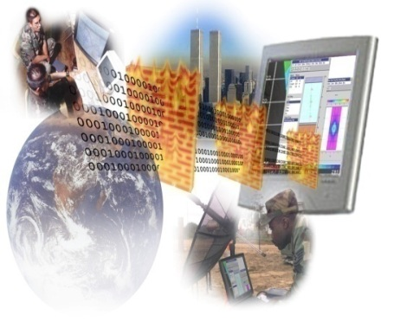

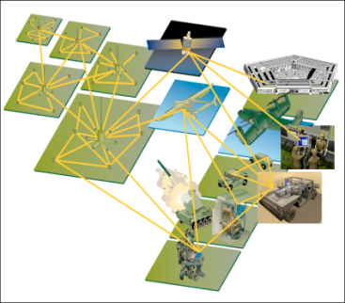
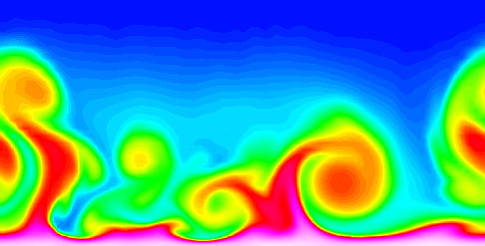
Large-scale Data is Everywhere!
There has been enormous data growth in both commercial and scientific databases due to advances in data generation and collection technologies
New mantra
Gather whatever data you can whenever and wherever possible.
Expectations
Gathered data will have value either for the purpose collected or for a purpose not envisioned.
E-Commerce
Cyber Security
Traffic Patterns
Social Networking: Twitter
Sensor Networks
Computational Simulations
Notes:
2

Slide 3




Why Data Mining? Commercial Viewpoint
Lots of data is being collected and warehoused
Web data
Google has Peta Bytes of web data
Facebook has billions of active users
purchases at department/ grocery stores, e-commerce
Amazon handles millions of visits/day
Bank/Credit Card transactions
Computers have become cheaper and more powerful
Competitive Pressure is Strong
Provide better, customized services for an edge (e.g. in Customer Relationship Management)
Notes:
3

Slide 4
Why Data Mining? Scientific Viewpoint
Data collected and stored at enormous speeds
remote sensors on a satellite
NASA EOSDIS archives over petabytes of earth science data / year
telescopes scanning the skies
Sky survey data
High-throughput biological data
scientific simulations
terabytes of data generated in a few hours
Data mining helps scientists
in automated analysis of massive datasets
In hypothesis formation
fMRI Data from Brain
Sky Survey Data
Gene Expression Data
Surface Temperature of Earth
Notes:
4

Slide 5
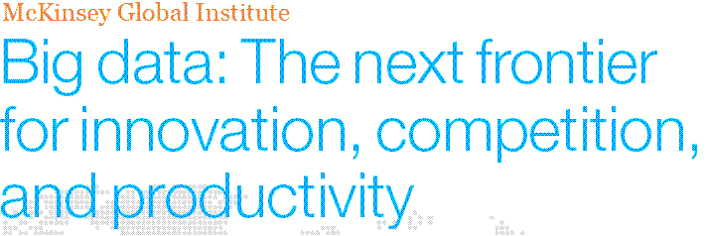
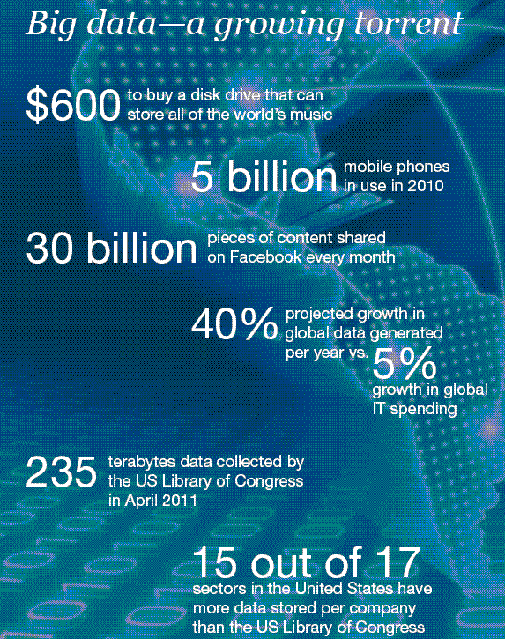
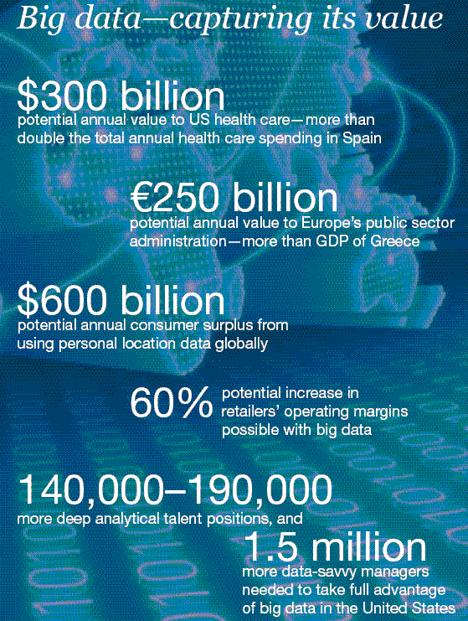
Great opportunities to improve productivity in all walks of life

Slide 6
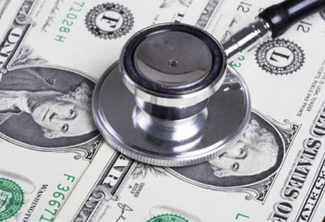
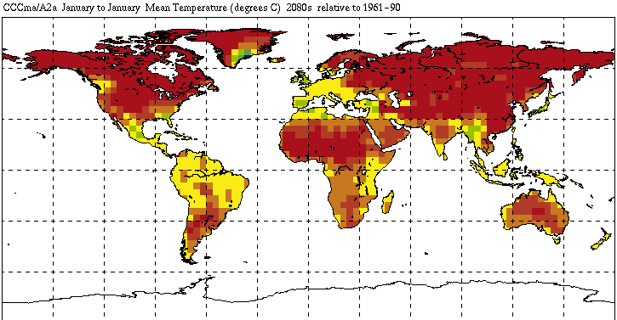
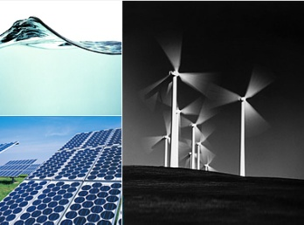
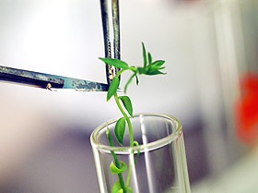
Great Opportunities to Solve Society’s Major Problems
Improving health care and reducing costs
Predicting the impact of climate change
Finding alternative/ green energy sources
Reducing hunger and poverty by
increasing agriculture production

Slide 7
What is Data Mining?
Many Definitions
Non-trivial extraction of implicit, previously unknown and potentially useful information from data
Exploration & analysis, by automatic or semi-automatic means, of large quantities of data in order to discover meaningful patterns

Slide 8
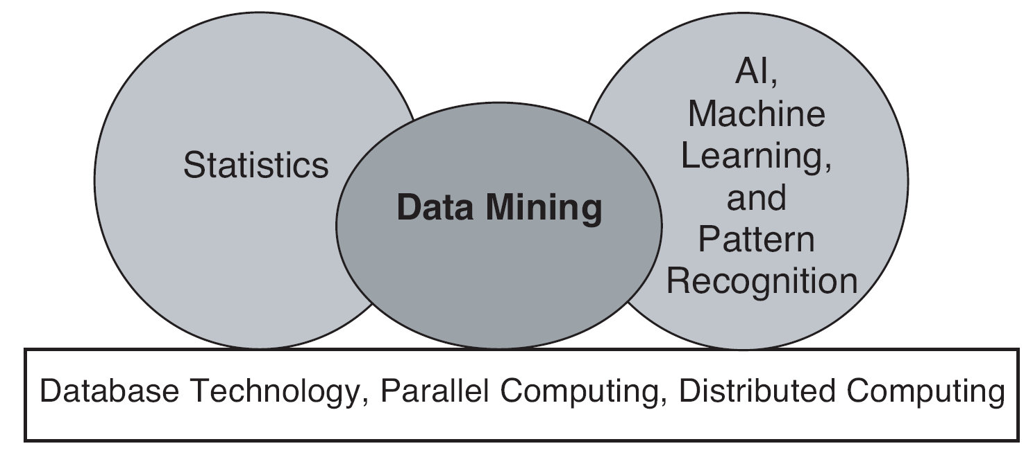
Origins of Data Mining
Draws ideas from machine learning/AI, pattern recognition, statistics, and database systems
Traditional techniques may be unsuitable due to data that is
Large-scale
High dimensional
Heterogeneous
Complex
Distributed
A key component of the emerging field of data science and data-driven discovery

Slide 9
Data Mining Tasks
Prediction Methods
Use some variables to predict unknown or future values of other variables.
Description Methods
Find human-interpretable patterns that describe the data.
From [Fayyad, et.al.] Advances in Knowledge Discovery and Data Mining, 1996

Slide 10
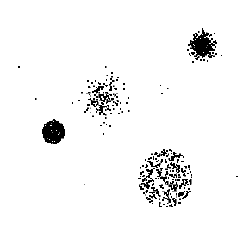

Data Mining Tasks …
Data
Clustering
Predictive Modeling
Association Rules
Anomaly Detection
Milk

Slide 11
Predictive Modeling: Classification
Find a model for class attribute as a function of the values of other attributes
Model for predicting credit worthiness
Class

Slide 12
Classification Example
categorical
categorical
quantitative
class
Test
Set
Learn
Classifier
Training
Set
Model

Slide 13
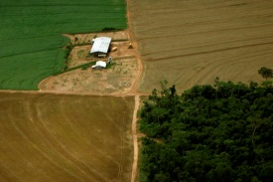
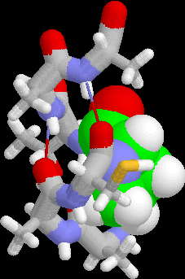
Examples of Classification Task
Classifying credit card transactions as legitimate or fraudulent
Classifying land covers (water bodies, urban areas, forests, etc.) using satellite data
Categorizing news stories as finance, weather, entertainment, sports, etc
Identifying intruders in the cyberspace
Predicting tumor cells as benign or malignant
Classifying secondary structures of protein as alpha-helix, beta-sheet, or random coil

Slide 14
Classification: Application 1
Fraud Detection
Goal: Predict fraudulent cases in credit card transactions.
Approach:
Use credit card transactions and the information on its account-holder as attributes.
When does a customer buy, what does he buy, how often he pays on time, etc
Label past transactions as fraud or fair transactions. This forms the class attribute.
Learn a model for the class of the transactions.
Use this model to detect fraud by observing credit card transactions on an account.

Slide 15
Classification: Application 2
Churn prediction for telephone customers
Goal: To predict whether a customer is likely to be lost to a competitor.
Approach:
Use detailed record of transactions with each of the past and present customers, to find attributes.
How often the customer calls, where he calls, what time-of-the day he calls most, his financial status, marital status, etc.
Label the customers as loyal or disloyal.
Find a model for loyalty.
From [Berry & Linoff] Data Mining Techniques, 1997

Slide 16
Classification: Application 3
Sky Survey Cataloging
Goal: To predict class (star or galaxy) of sky objects, especially visually faint ones, based on the telescopic survey images (from Palomar Observatory).
3000 images with 23,040 x 23,040 pixels per image.
Approach:
Segment the image.
Measure image attributes (features) - 40 of them per object.
Model the class based on these features.
Success Story: Could find 16 new high red-shift quasars, some of the farthest objects that are difficult to find!
From [Fayyad, et.al.] Advances in Knowledge Discovery and Data Mining, 1996

Slide 17
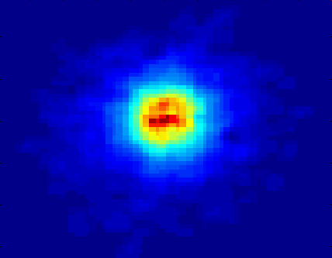
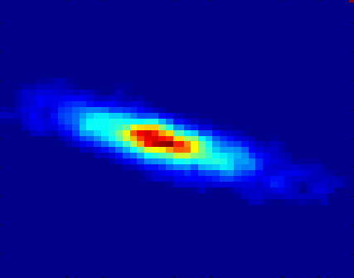
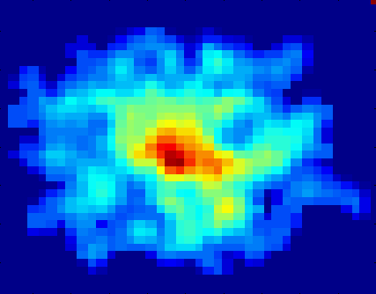
Classifying Galaxies
Courtesy: http://aps.umn.edu
Early
Class:
Stages of Formation
Attributes:
Image features,
Characteristics of light waves received, etc.
Intermediate
Late
Data Size:
72 million stars, 20 million galaxies
Object Catalog: 9 GB
Image Database: 150 GB

Slide 18
Regression
Predict a value of a given continuous valued variable based on the values of other variables, assuming a linear or nonlinear model of dependency.
Extensively studied in statistics, neural network fields.
Examples:
Predicting sales amounts of new product based on advetising expenditure.
Predicting wind velocities as a function of temperature, humidity, air pressure, etc.
Time series prediction of stock market indices.

Slide 19
Clustering
Finding groups of objects such that the objects in a group will be similar (or related) to one another and different from (or unrelated to) the objects in other groups
Inter-cluster distances are maximized
Intra-cluster distances are minimized

Slide 20
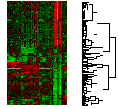
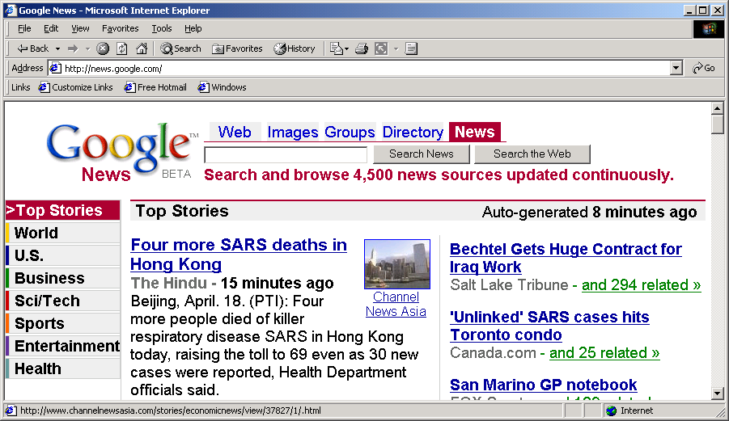
Applications of Cluster Analysis
Understanding
Custom profiling for targeted marketing
Group related documents for browsing
Group genes and proteins that have similar functionality
Group stocks with similar price fluctuations
Summarization
Reduce the size of large data sets
Courtesy: Michael Eisen
Use of K-means to partition Sea Surface Temperature (SST) and Net Primary Production (NPP) into clusters that reflect the Northern and Southern Hemispheres.

Slide 21
Clustering: Application 1
Market Segmentation:
Goal: subdivide a market into distinct subsets of customers where any subset may conceivably be selected as a market target to be reached with a distinct marketing mix.
Approach:
Collect different attributes of customers based on their geographical and lifestyle related information.
Find clusters of similar customers.
Measure the clustering quality by observing buying patterns of customers in same cluster vs. those from different clusters.

Slide 22
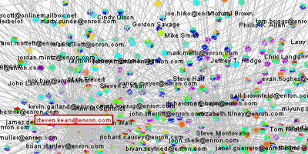
Clustering: Application 2
Document Clustering:
Goal: To find groups of documents that are similar to each other based on the important terms appearing in them.
Approach: To identify frequently occurring terms in each document. Form a similarity measure based on the frequencies of different terms. Use it to cluster.
Enron email dataset

Slide 23
Association Rule Discovery: Definition
Given a set of records each of which contain some number of items from a given collection
Produce dependency rules which will predict occurrence of an item based on occurrences of other items.
Rules Discovered:
{Milk} --> {Coke}
{Diaper, Milk} --> {Beer}

Slide 24
Association Analysis: Applications
Market-basket analysis
Rules are used for sales promotion, shelf management, and inventory management
Telecommunication alarm diagnosis
Rules are used to find combination of alarms that occur together frequently in the same time period
Medical Informatics
Rules are used to find combination of patient symptoms and test results associated with certain diseases

Slide 25
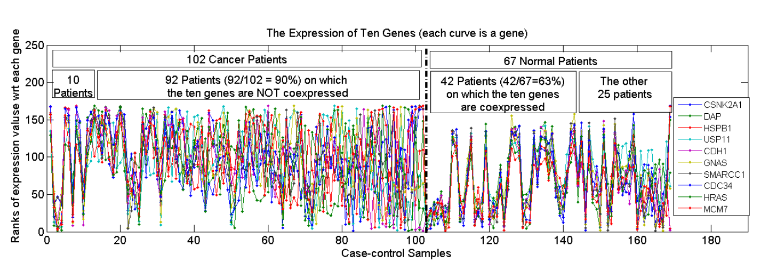
Association Analysis: Applications
An Example Subspace Differential Coexpression Pattern from lung cancer dataset
Enriched with the TNF/NFB signaling pathway
which is well-known to be related to lung cancer
P-value: 1.4*10⁻⁵ (6/10 overlap with the pathway)
Three lung cancer datasets [Bhattacharjee et al. 2001], [Stearman et al. 2005], [Su et al. 2007]
[Fang et al PSB 2010]

Slide 26
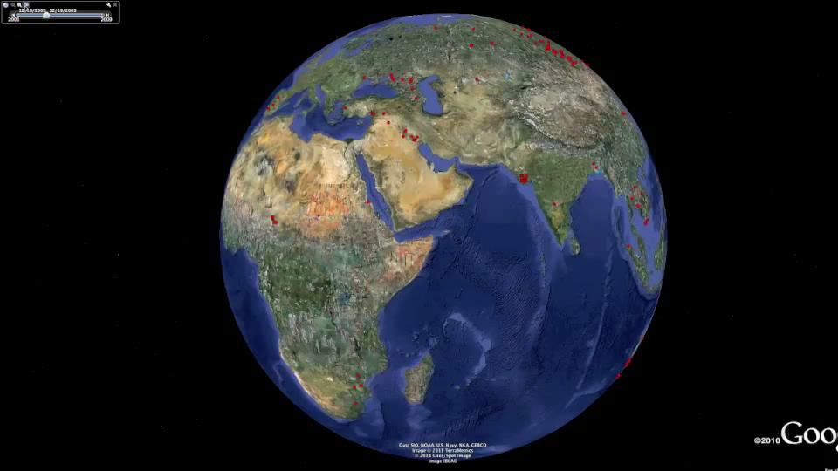
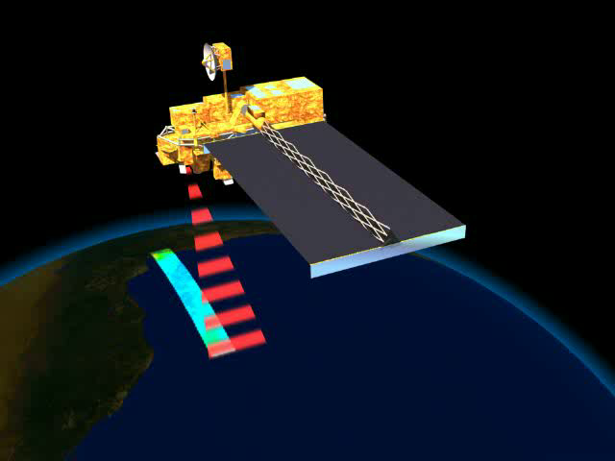
Deviation/Anomaly/Change Detection
Detect significant deviations from normal behavior
Applications:
Credit Card Fraud Detection
Network Intrusion Detection
Identify anomalous behavior from sensor networks for monitoring and surveillance.
Detecting changes in the global forest cover.

Slide 27
Motivating Challenges
Scalability
High Dimensionality
Heterogeneous and Complex Data
Data Ownership and Distribution
Non-traditional Analysis

